Slide 1
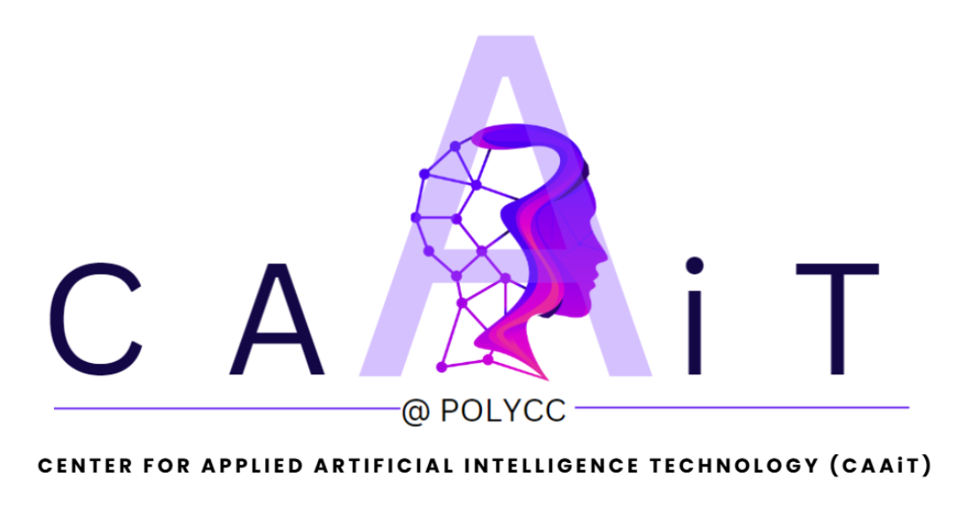
Prepared by : CAAiT

Slide 2
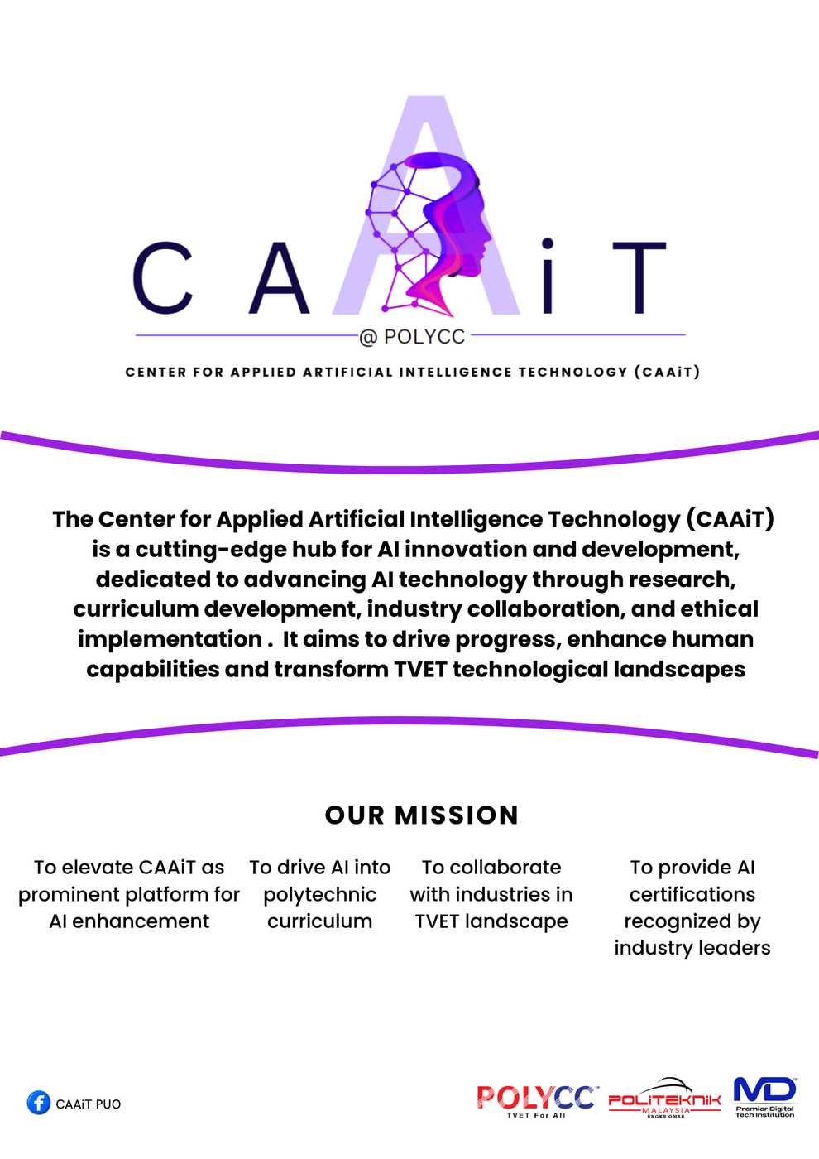

Slide 3


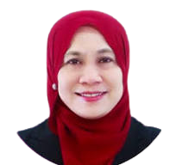
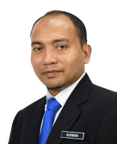
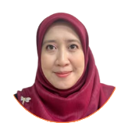
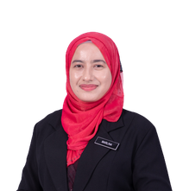
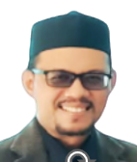
CAAIT
DR SHAMSURI B ABDULLAH
GENERAL DIRECTOR OF JPPKK
Structure
A. AZMAN B ARSHAD
DIRECTOR BPPI
DR SALMI CHE MEH
DIRECTOR PUO
NORMAN BIN ZAMRI
DEPUTY DIRECTOR (ACADEMIC)
AINIE HAYATI NORUZMAN
HEAD OF DEPARTMENTJTMK
TS. MARLINA ABDUL MANAF
HEAD
MOHAMAD AKHYARMOHD NOOR
ASSIST. HEAD
COORDINATOR (JKA)
COORDINATOR (JKE)
COORDINATOR (JKM)
COORDINATOR (JKP)
COORDINATOR (JTMK)
COORDINATOR (JP)
COORDINATOR (JPA)

Slide 4

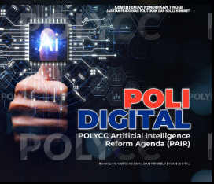









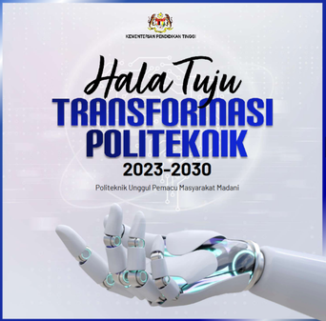







CAAIT OVERALL ROADMAP
CENTER FOR APPLIED ARTIFICIAL INTELLIGENCE TECHNOLOGY
Plans
Establishment of
CAAIT
Team Formation
Refine projects based on feedback, data insights, technology readiness and POLYCC transformation digital plan
Build multidisciplinary teams to explore AI trends and validate solution concepts
AUGUST 2024
Projects
Focus Area
Future Direction
Integrate AI-based solutions into industrial projects and curricula to align with institutional and industry needs serving back to the POLYCC stakeholders and community
Pilot applied AI applications to evaluate performance, scalability, and real-world impact.
Focus: talent development, knowledge sharing, curriculum development and AI ethics
Expand CAAIT’s innovations through commercialization, collaboration, and sustainable AI ecosystem development.
Impact: AI literacy & modern PdP

Slide 5
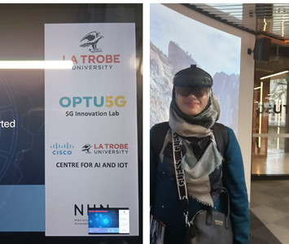
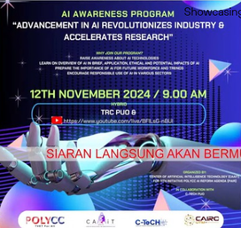
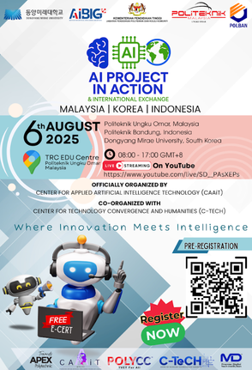
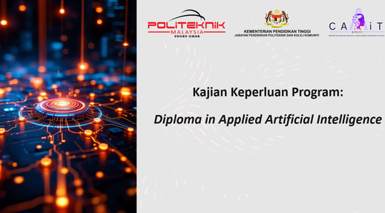
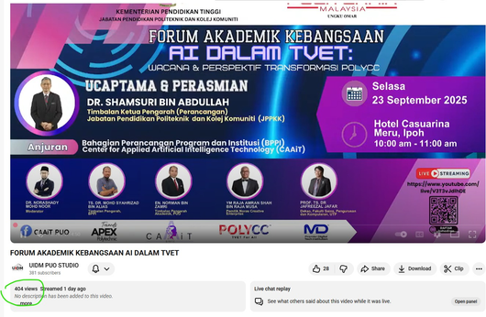








KEY PROGRAMS & ACHEIVEMENTS
Showcasing what CAAIT has done so far nationally and internationally
01
02
03
04
05
BENCHMARKING SERIES
IN 2024
AI AWARENESS PROGRAM
12th Nov 2024
AI PROJECT IN ACTION & INTERNATIONAL EXCHANGE
6th August 2025
PROGRAM NEED ANALYSIS RESEARCH
Research Period:
June-Sept 2025 |
Presented: 22nd Nov 2025
Status : Approved
FORUM AKADEMIK KEBANGSAAN
AI DALAM TVET: WACANA DAN PERSPEKTIF TRANSFORMASI POLYCC
23rd Sept 2025
Academic visit series to Institutions/ Active firms in Melbourne Australia organized by MDEC,
CAIRO UTM and HEJIM UKM to induce knowledge on facilities and setups
A hybrid sharing session on AI awareness and usage
CAAIT X CAIRO
400++ active streaming
A hybrid student series program with participation from polytechnic and community college. International sharing from South Korea and Bandung Indonesia.
CAAIT X AIBiG X KOREA X INDONESIA
2400++ active streaming
New program development and future curricular structure for new program (Diploma in Applied Artificial Intelligence)
Impact: Offering Diploma in Artificial Intelligence (2027)
Forum based program with the involvement of expert panels from institution, industry and accreditation agency
Impact : TVET Polytechnic strategic direction
400++ active streaming

Slide 6
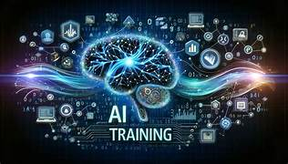
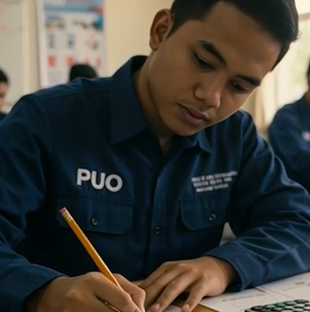






KEY PROGRAMS & ACHIEVEMENTS
Showcasing what CAAIT has done so far nationally and internationally
06
07
08
09
INDUSTRY COLLABORATION
LOI : 8TH OCT 2025
PODCAST
6th May 2025
TRAININGS & CERTIFICATIONS
2025-2026
AI VIDEO COMPETITION
2025 & 2026
CAAiT was invited as panel in podcast session. Discussing on how AI is transforming TVET. AI for All and TVET aims to make AI knowledge accessible to everyone by bridging technology, education, and innovation for a smarter tomorrow.
Ready and eagerly connect with the industries on any industrial based projects HanDe (M) industry is soon to set up an isolation AI plant by mid-2026 for its R&D projects in collaboration with CAAiT
Lecturers were actively involved in trainings organized by various agencies, industries and ministries
  DTex MDEC Programs
  SOLS Program
  AI Integration Design Program (UNIVERSITY OF NEW SOUTH WALES , SYDNEY)
The eDOLA video integrated various elements of AI. Its all about Business Model Canvas became the roadmap for student’s success entrepreneurial journey

Slide 7
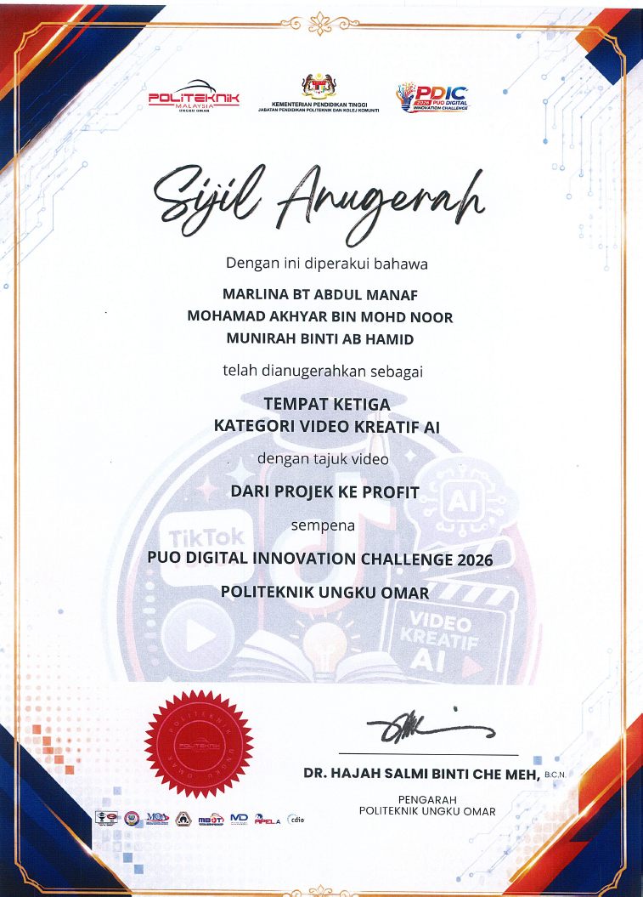


KEY PROGRAMS & ACHIEVEMENTS
Showcasing what CAAIT has done so far nationally and internationally
10
11
12
PUO Digital Innovation Challenge
3th-5th April 2026
PROGRAM
MADANI RAKYAT PERAK
3th-5th April 2026
FUTURE COLLABORATION
SAS Institute
CAAiT won no 3 for PDIC PUO competition
CAAiT was invited as panel in podcast session. Discussing on how AI is transforming TVET. AI for All and TVET aims to make AI knowledge accessible to everyone by bridging technology, education, and innovation for a smarter tomorrow.

Slide 8
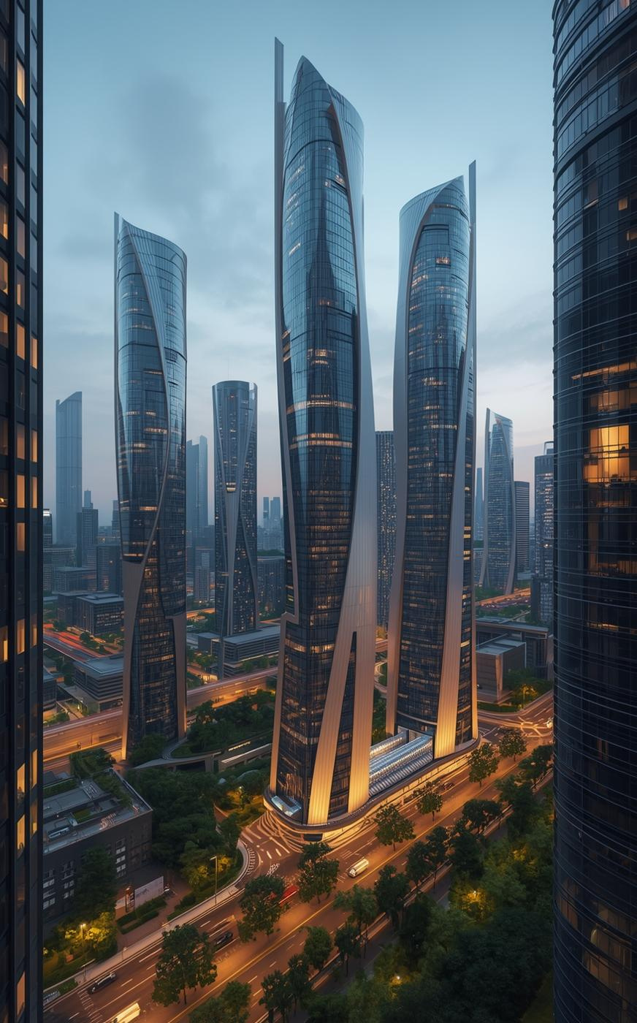

CAAIT
Future Directions
FUTURE DIRECTIONS
  Upcoming programs (e.g., Polytechnic AI, Diploma in Applied AI)
  Research priorities
  Regional, national and international level expansion goals
  Industry Connects
COLLABORATION & PARTNERSHIP OPPORTUNITIES
  Industry partners
  Academic collaborators
  Government agencies (e.g., Universities, MDEC, HRD Corp)
  Welcoming for collaborations / MoUs with industries

